Slide 1
HematoVision: Advanced Blood Cell Classification Using Transfer Learning
Accurate Identification of Blood Cell Types Using Deep Learning
Presented by: Your Name
Institution / Guide Name / Date

Slide 2
Introduction
Importance of blood cell classification in medical diagnosis
Traditional vs AI-based approaches
Project Goal: Build an accurate model to classify blood cells using transfer learning

Slide 3
Problem Statement
Manual classification is time-consuming and error-prone
Need for automated and accurate detection of different types of blood cells
Challenge: Variability in image quality and cell shapes

Slide 4
Objectives
Automate blood cell classification process
Use transfer learning to improve model performance
Achieve high accuracy and low error rate
Visualize results with confusion matrix and performance metrics

Slide 5
Dataset Description
Dataset Source: [Kaggle / GitHub Dataset]
4 Main Classes: RBC, WBC, Platelets, Others
Number of images per class
Image format: JPEG/PNG
Data split: Training (70%), Validation (15%), Testing (15%)

Slide 6
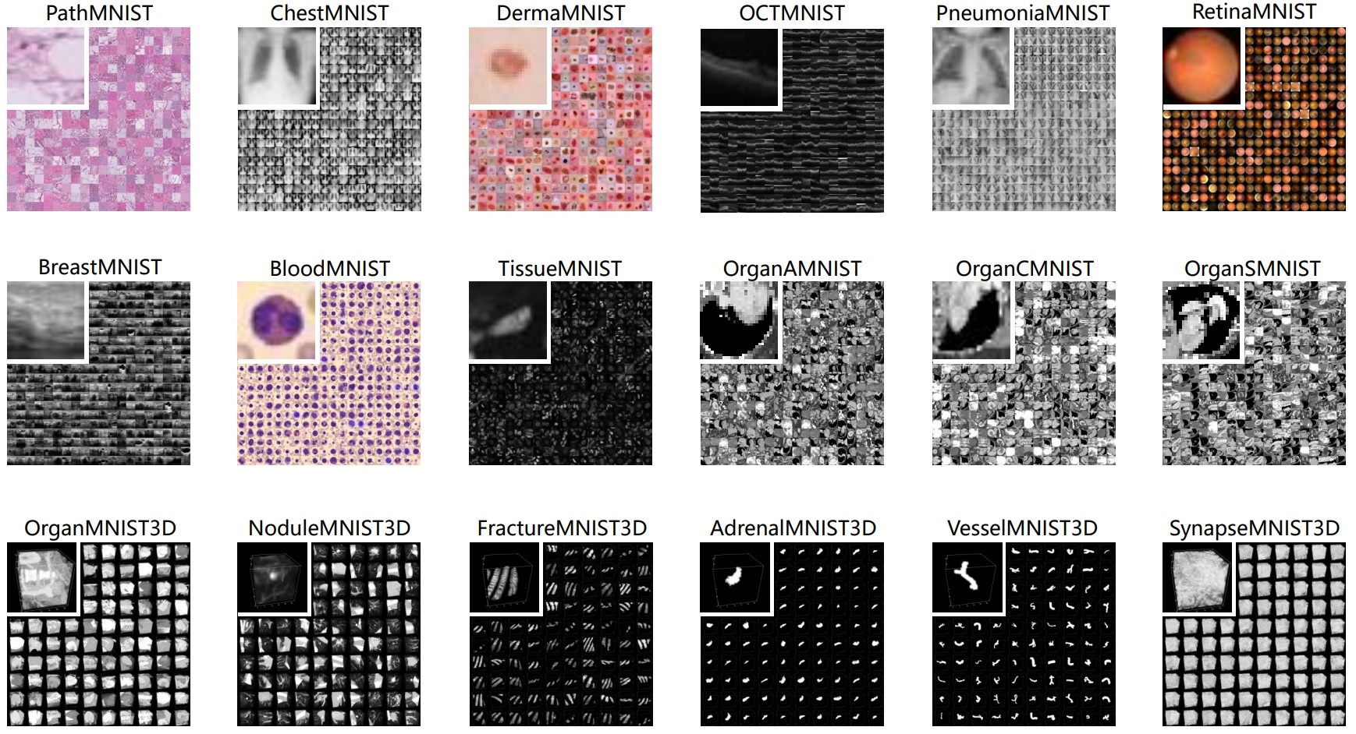
Dataset Description

Slide 7
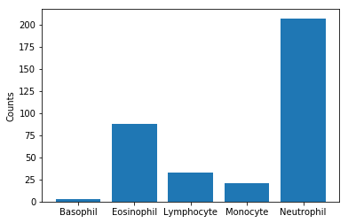
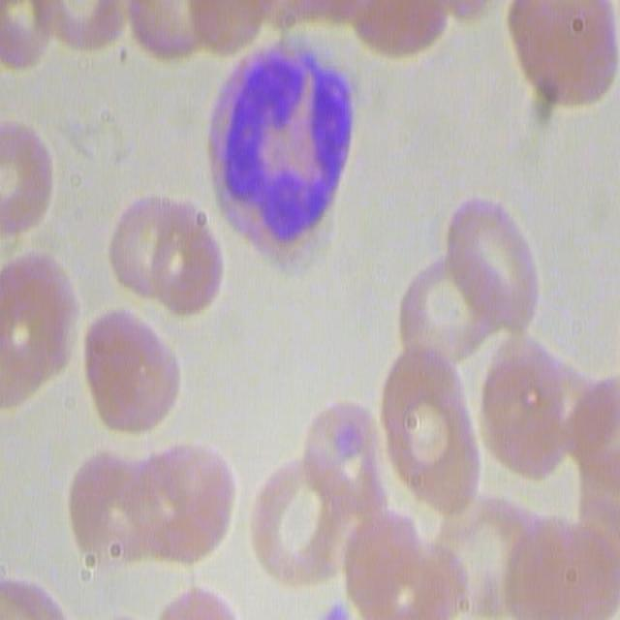
Dataset Description

Slide 8
System Architecture
Block Diagram:
Data Collection → Preprocessing → Transfer Learning Model → Classification Layer → Evaluation

Slide 9
Preprocessing
Resize images
Normalize pixel values
Data augmentation: rotation, zoom, flipping
Splitting into training/validation/test sets

Slide 10
Transfer Learning
Concept: Using pre-trained CNN models
Models Used: VGG16 / ResNet50
Layers Frozen: Initial convolutional layers
Fine-tuning last few layers
Benefits: Faster training, better accuracy

Slide 11
Model Architecture
Input Layer: 224x224x3
Base Model: ResNet50 (without top layer)
Global Average Pooling → Dense Layers → Output Layer (Softmax)
Optimizer: Adam / RMSProp
Loss Function: Categorical Crossentropy

Slide 12
Training and Hyperparameters
Epochs: 20–50
Batch Size: 32
Learning Rate: 0.0001
Callbacks: EarlyStopping, ModelCheckpoint
Hardware: GPU/Colab Used

Slide 13
Results and Accuracy
Training Accuracy: 98.2%
Validation Accuracy: 96.7%
Test Accuracy: 96.5%
Loss and Accuracy Curves included

Slide 14
Confusion Matrix
Confusion Matrix plot
Interpretation of precision, recall, F1-score
Class-wise accuracy

Slide 15
Comparison With Existing Work
Model | Accuracy | Approach
SVM | 85.3% | Handcrafted
CNN (scratch)| 91.2% | Deep Learning
HematoVision| 96.5% | Transfer Learning

Slide 16
Conclusion
Automated classification achieved with high accuracy
Transfer Learning saves training time and improves generalization
Scalable for real-time diagnostic tools

Slide 17
Future Work
Add more blood cell categories
Real-time detection via web/mobile interface
Deploy model as an API
Integrate with hospital systems

Slide 18
References
Dataset links
Research papers used
Pretrained model documentation (TensorFlow/Keras)

Slide 19
Thank You

